Slide 1
Chapter 7: Deadlocks

Slide 2
Chapter Objectives
Illustrate how deadlock can occur when mutex locks are used
Define the four necessary conditions that characterize deadlock
Identify a deadlock situation in a resource allocation graph
Evaluate the four different approaches for preventing deadlocks(死锁预防)
Apply the banker’s algorithm for deadlock avoidance(死锁避免)
Apply the deadlock detection(死锁检测) algorithm
Evaluate approaches for recovering from deadlock(死锁恢复)

Slide 3
Content Overview
The Deadlock Problem
System Model
Deadlock Characterization
Methods for Handling Deadlocks
Deadlock Prevention
Deadlock Avoidance
Deadlock Detection
Recovery from Deadlock

Slide 4
The Deadlock Problem
A set of blocked processes each holding a resource and waiting to acquire a resource held by another process in the set
Reasons
Resource competition
Execution sequence illegal
Example 1
System has 2 disk drives
P₁ and P₂ each hold one disk drive and each needs another one
Example 2
semaphores A and B, initialized to 1
P₀ P₁
wait (A); wait(B);
wait (B); wait(A);

Slide 5

Bridge Crossing Example
Traffic only in one direction
Each section of a bridge can be viewed as a resource
If a deadlock occurs, it can be resolved if one car backs up (preempt resources and rollback)
Several cars may have to be backed up if a deadlock occurs
Starvation is possible

Slide 6
7.1 System Model
System consists of resources
Resource types R₁, R₂, . . ., R_{m}
CPU cycles, memory space, I/O devices
Each resource type R_{i} has W_{i} instances
Each process utilizes a resource as follows:
request
use
release

Slide 7
Resources
可重用资源：可被多个进程多次使用
可抢占资源与不可抢占资源
处理器、I/O部件、内存、文件、数据库、信号量
可消耗资源：只可使用一次、可创建和销毁的资源
信号、中断、消息

Slide 8
7.2 Deadlock Characterization
Deadlock can arise if four conditions hold simultaneously
Mutual exclusion: only one process at a time can use a resource
Hold and wait: a process holding at least one resource is waiting to acquire additional resources held by other processes
No preemption: a resource can be released only voluntarily by the process holding it, after that process has completed its task
Circular wait: there exists a set {P₀, P₁, …, P_{n}} of waiting processes such that P₀ is waiting for a resource that is held by P₁, P₁ is waiting for a resource that is held by P₂, …, P_{n–1} is waiting for a resource that is held by P_{n}, and P_{n} is waiting for a resource that is held by P₀
Notes:
死锁特征：互斥；占有并等待；非抢占；循环等待

Slide 9
Resource-Allocation Graph
A set of vertices V and a set of edges E.
V is partitioned into two types:
P = {P₁, P₂, …, P_{n}}, the set consisting of all the processes in the system
R = {R₁, R₂, …, R_{m}}, the set consisting of all resource types in the system
request edge(申请边) – directed edge P_{i} → R_{j}
assignment edge(分配边) – directed edge R_{j} → P_{i}
Notes:
资源分配图

Slide 10
Resource-Allocation Graph (Cont.)
Process
Resource Type with 4 instances
P_{i} requests instance of R_{j}
P_{i} is holding an instance of R_{j}
P_{i}
R_{j}
P_{i}
R_{j}

Slide 11
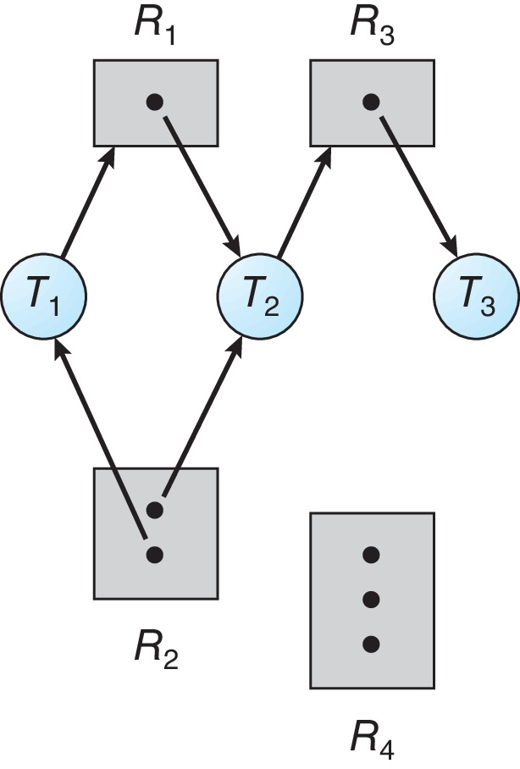
Resource Allocation Graph Example
One instance of R1
Two instances of R2
One instance of R3
Three instance of R4
T1 holds one instance of R2 and is waiting for an instance of R1
T2 holds one instance of R1, one instance of R2, and is waiting for an instance of R3
T3 is holds one instance of R3

Slide 12
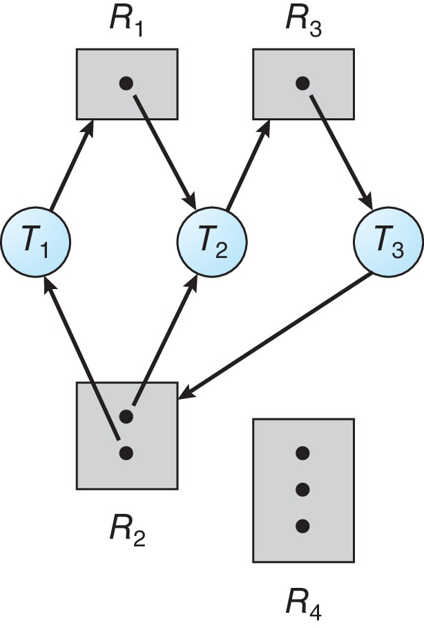
Resource Allocation Graph with a Deadlock

Slide 13
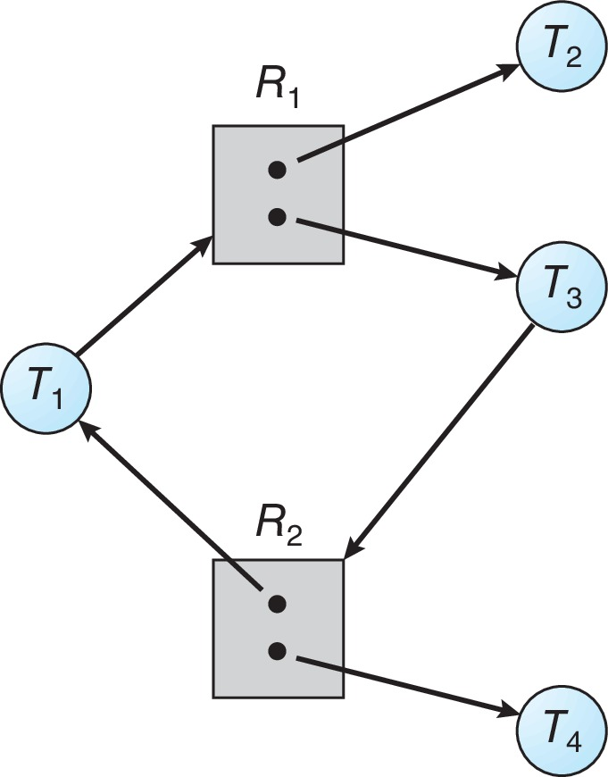
Graph with a Cycle But no Deadlock

Slide 14
Basic Facts(死锁定理)
If graph contains no cycles ⇒ no deadlock
If graph contains a cycle ⇒
if only one instance per resource type, then deadlock
if several instances per resource type, possibility of deadlock

Slide 15
7.3 Methods for Handling Deadlocks
Ensure that the system will never enter a deadlock state:
Deadlock prevention(死锁预防)
Deadlock avoidance(死锁避免)
Allow the system to enter a deadlock state and then recover
Ignore the problem and pretend that deadlocks never occur in the system.

Slide 16
Deadlock Prevention and Avoidance
Deadlock prevention(死锁预防)
静态策略：设计合适的资源分配算法，限制申请资源，确保至少一个必要条件不成立，不让死锁发生
Deadlock avoidance(死锁避免)
动态策略：OS事先得到有关进程申请资源和使用资源的额外信息，跟踪并评估资源分配过程，根据评估结果决策是否分配

Slide 17
7.4 Deadlock Prevention
Restrain the ways request can be made.
Invalidate one of the four necessary conditions for deadlock:
Mutual Exclusion – not required for sharable resources (e.g., read-only files); must hold for non-sharable resources
Hold and Wait – must guarantee that whenever a process requests a resource, it does not hold any other resources
Require process to request and be allocated all its resources before it begins execution, or allow process to request resources only when the process has none allocated to it.
Low resource utilization; starvation possible
Notes:
死锁预防：打破必要条件

Slide 18
Deadlock Prevention (Cont.)
No Preemption:
If a process that is holding some resources requests another resource that cannot be immediately allocated to it, then all resources currently being held are released
Preempted resources are added to the list of resources for which the process is waiting
Process will be restarted only when it can regain its old resources, as well as the new ones that it is requesting
Circular Wait:
Impose a total ordering of all resource types, and require that each process requests resources in an increasing order of enumeration
Notes:
可抢占的资源包括CPU寄存器，内存等状态可保存和恢复的资源

Slide 19
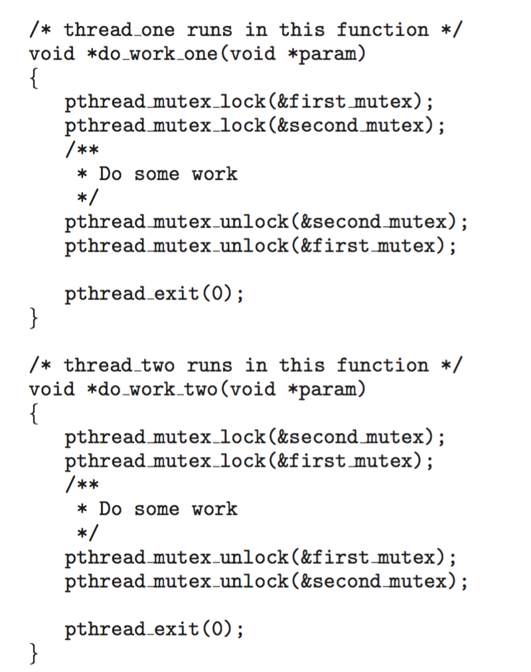
Circular Wait
Invalidating the circular wait condition is most common
Simply assign each resource (i.e., mutex locks) a unique number
Resources must be acquired in order
If: F(first_mutex) = 1 F(second_mutex) = 5 code for thread_two could not be written as follows:

Slide 20
7.5 Deadlock Avoidance
Requires that the system has some additional a priori information available
Simplest and most useful model requires that each process declare the maximum number of resources of each type that it may need
The deadlock-avoidance algorithm dynamically examines the resource-allocation state to ensure that there can never be a circular-wait condition
Resource-allocation state is defined by the number of available and allocated resources, and the maximum demands of the processes
Notes:
死锁避免：谨慎从事

Slide 21
Safe State
When a process requests an available resource, system must decide if immediate allocation leaves the system in a safe state
System is in safe state if there exists a sequence <P₁, P₂, …, P_{n}> of ALL the processes in the systems such that for each P_{i}, the resources that P_{i} can still request can be satisfied by currently available resources + resources held by all the P_{j}, with j < i

Slide 22
Safe State
That is:
If P_{i} resource needs are not immediately available, then P_{i} can wait until all P_{j} have finished
When P_{j} is finished, P_{i} can obtain needed resources, execute, return allocated resources, and terminate
When P_{i} terminates, P_{i +1} can obtain its needed resources, and so on

Slide 23
Basic Facts
If a system is in safe state ⇒ no deadlocks
If a system is in unsafe state ⇒ possibility of deadlock
Avoidance ⇒ ensure that a system will never enter an unsafe state.

Slide 24
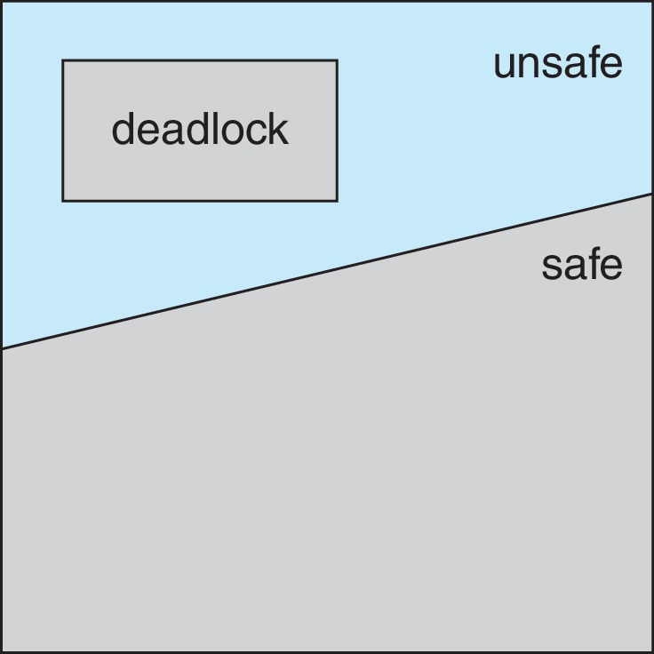
Safe, Unsafe, Deadlock State

Slide 25
Avoidance Algorithms
Single instance of a resource type
Use a resource-allocation graph
Multiple instances of a resource type
Use the Banker’s Algorithm

Slide 26
Resource-Allocation Graph Scheme
Claim edge(需求边) P_{i} → R_{j} indicated that process P_{j} may request resource R_{j}; represented by a dashed line
Claim edge converts to request edge when a process requests a resource
Request edge converted to an assignment edge when the resource is allocated to the process
When a resource is released by a process, assignment edge reconverts to a claim edge
Resources must be claimed a priori in the system

Slide 27
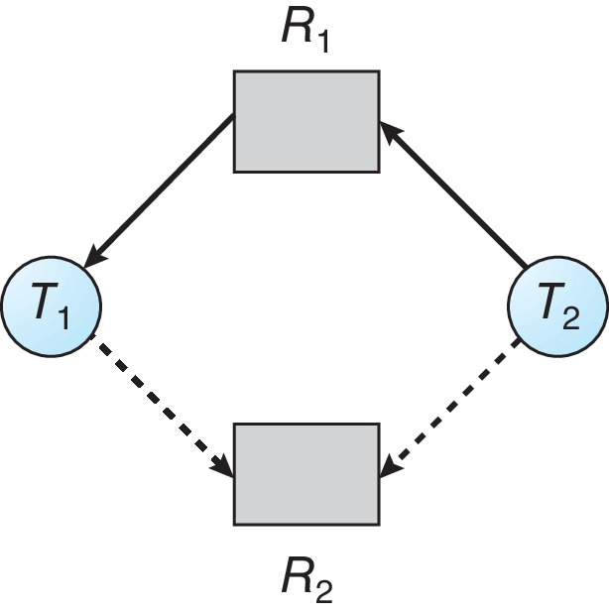
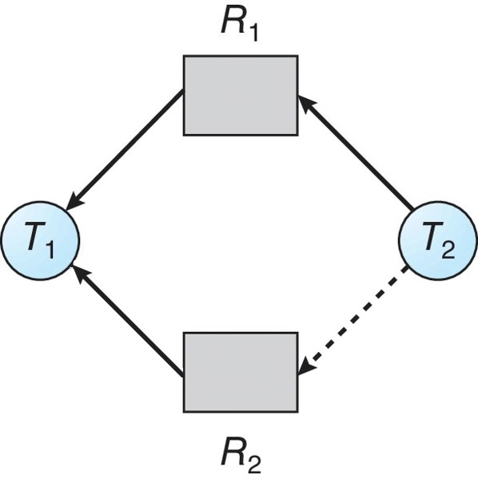
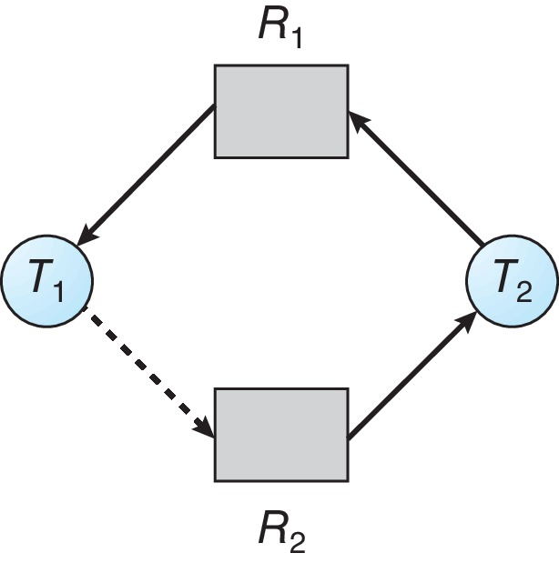
Resource-Allocation Graph and State
Safe
Unsafe

Slide 28
Resource-Allocation Graph Algorithm
Suppose that process P_{i} requests a resource R_{j}
The request can be granted only if converting the request edge to an assignment edge does not result in the formation of a cycle in the resource allocation graph

Slide 29
Banker’s Algorithm
Multiple instances of resources
Each process must a priori claim maximum use
When a process requests a resource it may have to wait
When a process gets all its resources it must return them in a finite amount of time
Notes:
银行家算法，Dijkstra 1965年提出

Slide 30
Data Structures for the Banker’s Algorithm
Let n = number of processes, and m = number of resources types.
Available: Vector of length m. If available [j] = k, there are k instances of resource type R_{j} available
Max: n x m matrix. If Max [i,j] = k, then process P_{i} may request at most k instances of resource type R_{j}
Allocation: n x m matrix. If Allocation[i,j] = k then P_{i} is currently allocated k instances of R_{j}
Need: n x m matrix. If Need[i,j] = k, then P_{i} may need k more instances of R_{j} to complete its task
Need [i,j] = Max[i,j] – Allocation [i,j]

Slide 31
Safety Algorithm
Let Work and Finish be vectors of length m and n, respectively. Initialize:
Work = Available
Finish [i] = false for i = 0, 1, …, n- 1
Find an i such that both:
(a) Finish [i] = false
(b) Need_{i} ≤ Work
If no such i exists, go to step 4
Work = Work + Allocation_{i} Finish[i] = true go to step 2
If Finish [i] == true for all i, then the system is in a safe state
Notes:
银行家算法中的安全性算法。复杂度为m*n*n

Slide 32
安全性算法
设Work(假想推进中的可分配资源) 和Finish 分别为长度为m 和n 的向量，并分别初始化为:
Work = Available
Finish [i] = false for i = 0, 1, …, n- 1
找到一个i ，并满足下面两条:
(a) Finish [i] = false
(b) Need_{i} ≤ Work
若不存在这样的i ，转 step 4
Work = Work + Allocation_{i} Finish[i] = true 转 step 2
若这时对所有的i, Finish [i] == true ，则系统处于安全状态，否则系统处于不安全状态
注意：对每一次进入step 2，可能有不止1个i 能满足这两条。
问题：是否殊途同归？
Notes:
银行家算法中的安全性算法。复杂度为m*n*n

Slide 33
Resource-Request Algorithm for Process P_{i}
Request_{i} = request vector for process P_{i}. If Request_{i} [j] = k then process P_{i} wants k instances of resource type R_{j}
If Request_{i} ≤ Need_{i} go to step 2. Otherwise, raise error condition, since process has exceeded its maximum claim
If Request_{i} ≤ Available, go to step 3. Otherwise P_{i} must wait, since resources are not available
Pretend to allocate requested resources to P_{i} by modifying the state as follows:
Available = Available – Request_{i};
Allocation_{i} = Allocation_{i} + Request_{i};
Need_{i} = Need_{i} – Request_{i};
If safe ⇒ the resources are allocated to P_{i}
If unsafe ⇒ P_{i} must wait, and the old resource-allocation state is restored
Notes:
银行家算法中的资源请求算法

Slide 34
Example of Banker’s Algorithm - 0
5 processes P0 through P4; 3 resource types:
A (10 instances), B (5 instances), and C (7 instances)
Snapshot at time T0:
 | Allocation | Max | Available |  | Need
 | A B C | A B C | A3 B3 C2 |  | A B C
P₀ | 0 1 0 | 7 5 3 |  | P₀ | 7 4 3
P₁ | 2 0 0 | 3 2 2 |  | P₁ | 1 2 2
P₂ | 3 0 2 | 9 0 2 |  | P₂ | 6 0 0
P₃ | 2 1 1 | 2 2 2 |  | P₃ | 0 1 1
P₄ | 0 0 2 | 4 3 3 |  | P₄ | 4 3 1
The system is in a safe state since the sequence
< P₁, P₃, P₄, P₂, P₀> satisfies safety criteria

Slide 35
Example of Banker’s Algorithm - 1
5 processes P0 through P4; 3 resource types:
A (10 instances), B (5 instances), and C (7 instances)
Snapshot at time T0:
 | Allocation | Max | Available |  | Need
 | A B C | A B C | A3 B3 C2 |  | A B C
P₀ | 0 1 0 | 7 5 3 |  | P₀ | 7 4 3
P₁ | 2 0 0 | 3 2 2 |  | P₁ | 1 2 2
P₂ | 3 0 2 | 9 0 2 |  | P₂ | 6 0 0
P₃ | 2 1 1 | 2 2 2 |  | P₃ | 0 1 1
P₄ | 0 0 2 | 4 3 3 |  | P₄ | 4 3 1

Slide 36
Example of Banker’s Algorithm – 1.5
5 processes P0 through P4; 3 resource types:
A (10 instances), B (5 instances), and C (7 instances)
Snapshot at time T0:
 | Allocation | Max | Available |  | Need
 | A B C | A B C | A3 B3 C2 |  | A B C
P₀ | 0 1 0 | 7 5 3 |  | P₀ | 7 4 3
P₁ | 3 2 2 | 3 2 2 | 2 1 0 | P₁ | 1 2 2
P₂ | 3 0 2 | 9 0 2 |  | P₂ | 6 0 0
P₃ | 2 1 1 | 2 2 2 |  | P₃ | 0 1 1
P₄ | 0 0 2 | 4 3 3 |  | P₄ | 4 3 1

Slide 37
Example of Banker’s Algorithm - 2
5 processes P0 through P4; 3 resource types:
A (10 instances), B (5 instances), and C (7 instances)
Snapshot at time T0:
 | Allocation | Max | Available |  | Need
 | A B C | A B C | A3 B3 C2 |  | A B C
P₀ | 0 1 0 | 7 5 3 |  | P₀ | 7 4 3
P₁ | 2 0 0 | 3 2 2 | 5 3 2 | P₁ | 1 2 2
P₂ | 3 0 2 | 9 0 2 |  | P₂ | 6 0 0
P₃ | 2 1 1 | 2 2 2 |  | P₃ | 0 1 1
P₄ | 0 0 2 | 4 3 3 |  | P₄ | 4 3 1
< P₁, ……………>

Slide 38
Example of Banker’s Algorithm - 3
5 processes P0 through P4; 3 resource types:
A (10 instances), B (5 instances), and C (7 instances)
Snapshot at time T0:
 | Allocation | Max | Available |  | Need
 | A B C | A B C | A3 B3 C2 |  | A B C
P₀ | 0 1 0 | 7 5 3 |  | P₀ | 7 4 3
P₁ | 2 0 0 | 3 2 2 | 5 3 2 | P₁ | 1 2 2
P₂ | 3 0 2 | 9 0 2 |  | P₂ | 6 0 0
P₃ | 2 1 1 | 2 2 2 |  | P₃ | 0 1 1
P₄ | 0 0 2 | 4 3 3 |  | P₄ | 4 3 1
< P₁, ……………>

Slide 39
Example of Banker’s Algorithm - 4
5 processes P0 through P4; 3 resource types:
A (10 instances), B (5 instances), and C (7 instances)
Snapshot at time T0:
 | Allocation | Max | Available |  | Need
 | A B C | A B C | A3 B3 C2 |  | A B C
P₀ | 0 1 0 | 7 5 3 |  | P₀ | 7 4 3
P₁ | 2 0 0 | 3 2 2 | 5 3 2 | P₁ | 1 2 2
P₂ | 3 0 2 | 9 0 2 |  | P₂ | 6 0 0
P₃ | 2 1 1 | 2 2 2 | 7 4 3 | P₃ | 0 1 1
P₄ | 0 0 2 | 4 3 3 |  | P₄ | 4 3 1
< P₁, P₃……………>

Slide 40
Example of Banker’s Algorithm - 5
5 processes P0 through P4; 3 resource types:
A (10 instances), B (5 instances), and C (7 instances)
Snapshot at time T0:
 | Allocation | Max | Available |  | Need
 | A B C | A B C | A3 B3 C2 |  | A B C
P₀ | 0 1 0 | 7 5 3 |  | P₀ | 7 4 3
P₁ | 2 0 0 | 3 2 2 | 5 3 2 | P₁ | 1 2 2
P₂ | 3 0 2 | 9 0 2 |  | P₂ | 6 0 0
P₃ | 2 1 1 | 2 2 2 | 7 4 3 | P₃ | 0 1 1
P₄ | 0 0 2 | 4 3 3 |  | P₄ | 4 3 1
< P₁, P₃……………>

Slide 41
Example of Banker’s Algorithm - 6
5 processes P0 through P4; 3 resource types:
A (10 instances), B (5 instances), and C (7 instances)
Snapshot at time T0:
 | Allocation | Max | Available |  | Need
 | A B C | A B C | A3 B3 C2 |  | A B C
P₀ | 0 1 0 | 7 5 3 |  | P₀ | 7 4 3
P₁ | 2 0 0 | 3 2 2 | 5 3 2 | P₁ | 1 2 2
P₂ | 3 0 2 | 9 0 2 |  | P₂ | 6 0 0
P₃ | 2 1 1 | 2 2 2 | 7 4 3 | P₃ | 0 1 1
P₄ | 0 0 2 | 4 3 3 | 7 4 5 | P₄ | 4 3 1
< P₁, P₃, P₄…………>

Slide 42
Example of Banker’s Algorithm - 7
5 processes P0 through P4; 3 resource types:
A (10 instances), B (5 instances), and C (7 instances)
Snapshot at time T0:
 | Allocation | Max | Available |  | Need
 | A B C | A B C | A3 B3 C2 |  | A B C
P₀ | 0 1 0 | 7 5 3 |  | P₀ | 7 4 3
P₁ | 2 0 0 | 3 2 2 | 5 3 2 | P₁ | 1 2 2
P₂ | 3 0 2 | 9 0 2 |  | P₂ | 6 0 0
P₃ | 2 1 1 | 2 2 2 | 7 4 3 | P₃ | 0 1 1
P₄ | 0 0 2 | 4 3 3 | 7 4 5 | P₄ | 4 3 1
< P₁, P₃, P₄…………>

Slide 43
Example of Banker’s Algorithm - 8
5 processes P0 through P4; 3 resource types:
A (10 instances), B (5 instances), and C (7 instances)
Snapshot at time T0:
 | Allocation | Max | Available |  | Need
 | A B C | A B C | A3 B3 C2 |  | A B C
P₀ | 0 1 0 | 7 5 3 |  | P₀ | 7 4 3
P₁ | 2 0 0 | 3 2 2 | 5 3 2 | P₁ | 1 2 2
P₂ | 3 0 2 | 9 0 2 | 10 4 7 | P₂ | 6 0 0
P₃ | 2 1 1 | 2 2 2 | 7 4 3 | P₃ | 0 1 1
P₄ | 0 0 2 | 4 3 3 | 7 4 5 | P₄ | 4 3 1
< P₁, P₃, P₄, P₂……>

Slide 44
Example of Banker’s Algorithm - 9
5 processes P0 through P4; 3 resource types:
A (10 instances), B (5 instances), and C (7 instances)
Snapshot at time T0:
 | Allocation | Max | Available |  | Need
 | A B C | A B C | A3 B3 C2 |  | A B C
P₀ | 0 1 0 | 7 5 3 |  | P₀ | 7 4 3
P₁ | 2 0 0 | 3 2 2 | 5 3 2 | P₁ | 1 2 2
P₂ | 3 0 2 | 9 0 2 | 10 4 7 | P₂ | 6 0 0
P₃ | 2 1 1 | 2 2 2 | 7 4 3 | P₃ | 0 1 1
P₄ | 0 0 2 | 4 3 3 | 7 4 5 | P₄ | 4 3 1
< P₁, P₃, P₄, P₂……>

Slide 45
Example of Banker’s Algorithm - 10
5 processes P0 through P4; 3 resource types:
A (10 instances), B (5 instances), and C (7 instances)
Snapshot at time T0:
 | Allocation | Max | Available |  | Need
 | A B C | A B C | A3 B3 C2 |  | A B C
P₀ | 0 1 0 | 7 5 3 | 10 5 7 | P₀ | 7 4 3
P₁ | 2 0 0 | 3 2 2 | 5 3 2 | P₁ | 1 2 2
P₂ | 3 0 2 | 9 0 2 | 10 4 7 | P₂ | 6 0 0
P₃ | 2 1 1 | 2 2 2 | 7 4 3 | P₃ | 0 1 1
P₄ | 0 0 2 | 4 3 3 | 7 4 5 | P₄ | 4 3 1
< P₁, P₃, P₄, P₂, P₀> Done

Slide 46
Example of Banker’s Algorithm - 11
Snapshot at time T0
The system is in a safe state since the sequence
< P₁, P₃, P₄, P₂, P₀> satisfies safety criteria
 | Allocation | Max | Available |  | Need
 | A B C | A B C | A3 B3 C2 |  | A B C
P₀ | 0 1 0 | 7 5 3 |  | P₀ | 7 4 3
P₁ | 2 0 0 | 3 2 2 |  | P₁ | 1 2 2
P₂ | 3 0 2 | 9 0 2 |  | P₂ | 6 0 0
P₃ | 2 1 1 | 2 2 2 |  | P₃ | 0 1 1
P₄ | 0 0 2 | 4 3 3 |  | P₄ | 4 3 1

Slide 47
Example: P₁ Request (1,0,2)
Check that Request ≤ Need (that is, (1,0,2) ≤ (1,2,2) ⇒ true
Check that Request ≤ Available (that is, (1,0,2) ≤ (3,3,2) ⇒ true
Allocation Need Available
A B C A B C A B C
P₀ 0 1 0 7 4 3 2 3 0
P₁ 3 0 2 0 2 0
P₂ 3 0 2 6 0 0
P₃ 2 1 1 0 1 1
P₄ 0 0 2 4 3 1
Executing safety algorithm shows that sequence < P₁, P₃, P₄, P₀, P₂> satisfies safety requirement
Can request for (3,3,0) by P₄ be granted?
Can request for (0,2,0) by P₀ be granted?
Notes:
指在前面一页图的状态下，P1再申请(1, 0, 2)。
Available = (3, 3, 2) – (1, 0, 2) = (2, 3, 0); Allocation1 = (2, 0, 0) + (1, 0, 2) = (3, 0, 2); Need1 = (1, 2, 2) – (1, 0, 2) = (0, 2, 0)。 Work = (2, 3, 0);
After P1: Work += Allocation1 = (2, 3, 0) + (3, 0, 2) = (5, 3, 2);
After P3: Work += Allocation3 = (5, 3, 2) + (2, 1, 1) = (7, 4, 3);
After P4: Work += Allocation4 = (7, 4, 3) + (0, 0, 2) = (7, 4, 5);
After P0: Work += Allocation0 = (7, 4, 5) + (0, 1, 0) = (7, 5, 5);
After P2: Work += Allocation2 = (7, 5, 5) + (3, 0, 2) = (10, 5, 7);
All done, safe.

Slide 48
银行家算法应用条件
在固定数量的进程中共享数量固定的资源
每个进程预先指定完成工作所需的最大资源数量
进程不能申请比系统中可用资源总数还多的资源
进程等待资源的时间是有限的
如果系统满足了进程对资源的最大需求，那么，进程应该在有限的时间内使用资源，然后归还给系统
进程彼此之间没有顺序关系(不需要进程间协作同步)

Slide 49
7.6 Deadlock Detection
Allow system to enter deadlock state
Detection algorithm
Recovery scheme

Slide 50
Single Instance of Each Resource Type
Maintain wait-for graph
Nodes are processes
P_{i} → P_{j} if P_{i} is waiting for P_{j}
Periodically invoke an algorithm that searches for a cycle in the graph. If there is a cycle, there exists a deadlock
An algorithm to detect a cycle in a graph requires an order of n² operations, where n is the number of vertices in the graph

Slide 51
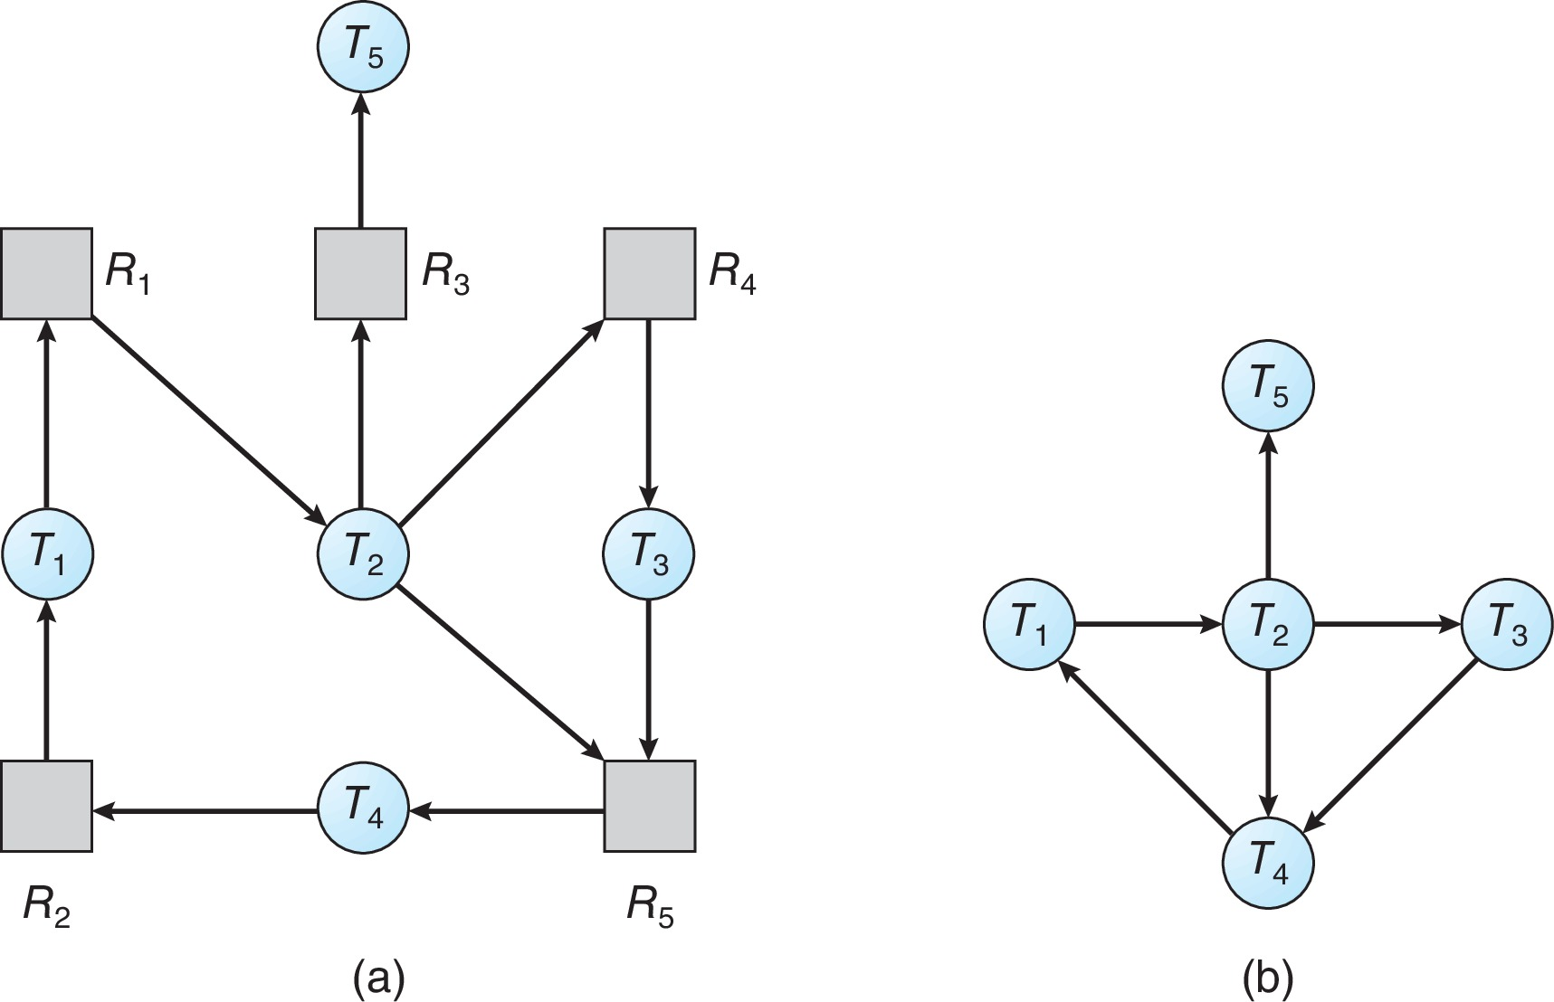
Resource-Allocation Graph and Wait-for Graph
Resource-Allocation Graph
Corresponding wait-for graph

Slide 52
Several Instances of a Resource Type
Available: A vector of length m indicates the number of available resources of each type
Allocation: An n x m matrix defines the number of resources of each type currently allocated to each process
Request: An n x m matrix indicates the current request of each process. If Request [i][j] = k, then process P_{i} is requesting k more instances of resource type R_{j}.

Slide 53
Detection Algorithm
Let Work and Finish be vectors of length m and n, respectively initialize:
Work = Available
For i = 0,2, …, n-1, if Allocation_{i} ≠ 0, then Finish[i] = false; otherwise, Finish[i] = true
Find an index i such that both:
Finish[i] == false
Request_{i} ≤ Work
If no such i exists, go to step 4

Slide 54
Detection Algorithm (Cont.)
Work = Work + Allocation_{i} Finish[i] = true go to step 2
If Finish[i] == false, for some i, 0 ≤ i < n, then the system is in deadlock state. Moreover, if Finish[i] == false, then P_{i} is deadlocked
Algorithm requires an order of O(m x n²) operations to detect whether the system is in deadlocked state
Notes:
仔细观察，银行家算法和检测死锁算法有什么不同？

Slide 55
Example of Detection Algorithm
Five processes P₀ through P₄; three resource types A (7 instances), B (2 instances), and C (6 instances)
Snapshot at time T₀:
Allocation Request Available
A B C A B C A B C
P₀ 0 1 0 0 0 0 0 0 0
P₁ 2 0 0 2 0 2
P₂ 3 0 3 0 0 0
P₃ 2 1 1 1 0 0
P₄ 0 0 2 0 0 2
Sequence <P₀, P₂, P₃, P₁, P₄> will result in Finish[i] = true for all i

Slide 56
Example (Cont.)
P₂ requests an additional instance of type C
Request
A B C
P₀ 0 0 0
P₁ 2 0 2
P₂ 0 0 1
P₃ 1 0 0
P₄ 0 0 2
State of system?
Can reclaim resources held by process P₀, but insufficient resources to fulfill other processes’ requests
Deadlock exists, consisting of processes P₁, P₂, P₃, and P₄
Allocation Request Available
A B C A B C A B C
P₀ 0 1 0 0 0 0 0 0 0
P₁ 2 0 0 2 0 2
P₂ 3 0 3 0 0 0
P₃ 2 1 1 1 0 0
P₄ 0 0 2 0 0 2

Slide 57
Detection-Algorithm Usage
When, and how often, to invoke depends on:
How often a deadlock is likely to occur?
How many processes will need to be rolled back?
one for each disjoint cycle
If detection algorithm is invoked arbitrarily, there may be many cycles in the resource graph and so we would not be able to tell which of the many deadlocked processes “caused” the deadlock.

Slide 58
7.7 Recovery from Deadlock: Process Termination
Abort all deadlocked processes
Abort one process at a time until the deadlock cycle is eliminated
In which order should we choose to abort?
Priority of the process
How long process has computed, and how much longer to completion
Resources the process has used
Resources process needs to complete
How many processes will need to be terminated
Is process interactive or batch?

Slide 59
Recovery from Deadlock: Resource Preemption
Selecting a victim – minimize cost
Rollback – return to some safe state, restart process for that state
Starvation – same process may always be picked as victim, include number of rollback in cost factor

Slide 60
Summary 1/2
Deadlock occurs in a set of processes when every process in the set is waiting for an event that can only be caused by another process in the set.
There are four necessary conditions for deadlock: (1) mutual exclusion, (2) hold and wait, (3) no preemption, and (4) circular wait. Deadlock is only possible when all four conditions are present.
Deadlocks can be modeled with resource-allocation graphs, where a cycle indicates deadlock.
Deadlocks can be prevented by ensuring that one of the four necessary conditions for deadlock cannot occur. Of the four necessary conditions, eliminating the circular wait is the only practical approach.

Slide 61
Summary 2/2
Deadlock can be avoided by using the banker’s algorithm, which does not grant resources if doing so would lead the system into an unsafe state where deadlock would be possible.
A deadlock-detection algorithm can evaluate processes and resources on a running system to determine if a set of processes is in a deadlocked state.
If deadlock does occur, a system can attempt to recover from the deadlock by either aborting one of the processes in the circular wait or preempting resources that have been assigned to a deadlocked process.

Slide 62
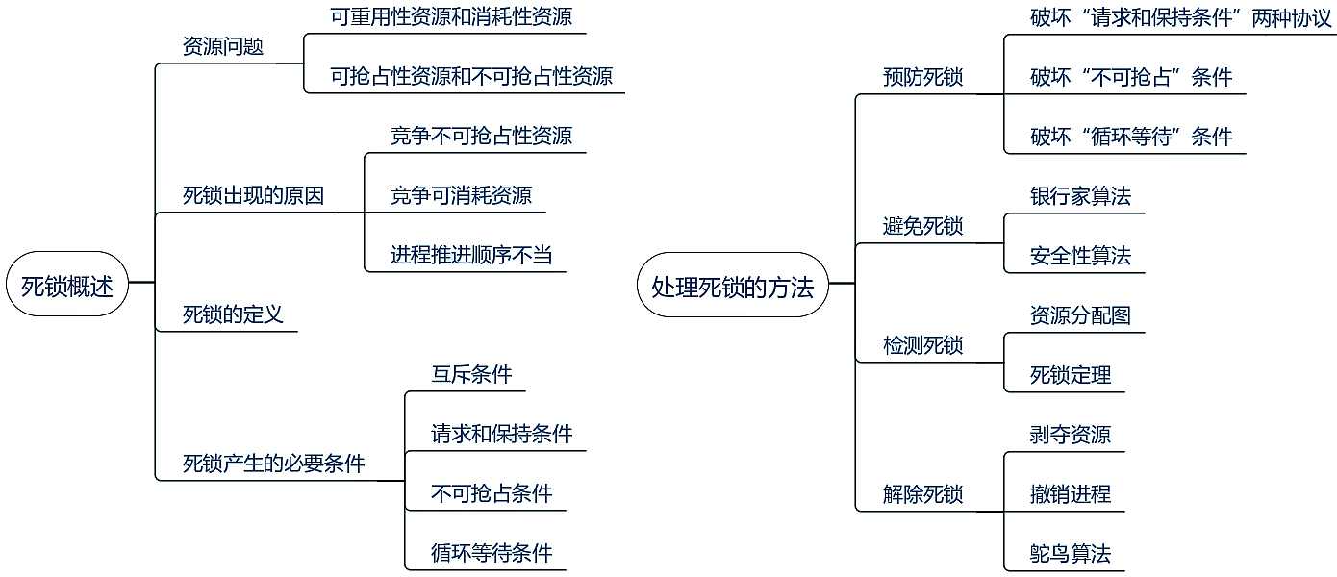
Mind Map of Deadlocks

Slide 63
End of Chapter 7: Deadlocks

